Slide 1

Food Customized App for Health-Conscious Users
GUIDE NAME: Ms.S.Murugavalli.,M.E.,(Ph.D)
TEAM MEMBERS:
SANGEETHA S (811721243047)
UDHAYAMALATHI N (811721243059)
VASANTHA PRIYA M (811721243060)
1

Slide 2
OBJECTIVE Allow users to adjust ingredients in real-time based on their health requirements, such as’ lower sugar’, ‘lower salt’, or specific spice levels. Enable users to customize their meals based on dietary preferences (e.g., vegan, keto, gluten-free).Provide an easy-to-use interface that allows users to quickly customize food and order it for home delivery. Ensure that the app is available to everyone including patients with chronic health conditions, those following strict diets, or just regular users. Show real-time updates on how ingredient changes affect nutritional content, allowing users to make informed decisions about their meals.

Slide 3
PROBLEM DEFINITION
Existing System:
The Existing System allow users to browse restaurant menus and place orders, but they lack any substantial customization options beyond basic choices like “no onions” or “extra cheese.” Most apps do not allow users to adjust the ‘ingredients’ or ‘nutritional levels’ (such as sugar, salt, or spice levels) to accommodate specific health conditions or dietary preferences.
Proposed System:
The Proposed System aims to fill the gaps left by existing food delivery platforms by providing an advanced food customization experience. This system will allow users to adjust various aspects of their meals, including sugar levels, salt content, spice levels, and more, to match their dietary needs or health conditions.

Slide 4
LITERATURE SURVEY
S.NO | PAPER TITLE | AUTHOR NAME | YEAR PUBLISHED | TECHNIQUE USED | DEMERITS
1. | A Survey on food ordering systems: Challenges and opportunities. | S. S.Lyer. | 2020 | Predictive analytics, Dynamic pricing, Route optimization. | Unauthorized access, Difficulty with order modification.
2. | A Comparative Analysis of food ordering apps: functionalities, security and user experience. | M.A.Al-Shammari. | 2021 | Cloud computing , DBMS, Recommendation Engine | Poor Navigation, Limited Features.

Slide 5
S.NO | PAPER TITLE | AUTHOR NAME | YEAR PUBLISHED | TECHNIQUE USED | DEMERITS
3. | Food ordering apps : A systematic review of features, benefits and challenges. | R.kumar. | 2023 | Order tracking, payment gateway integration, Push notification. | Slow loading time or System crashes.
4. | Online food ordering system in restaurants. | Ms.Manisha Meshram. | 2023 | Point of Sale Systems, Digital menus and online ordering, Voice ordering. | Technical difficulties with payment processing.

Slide 6
S.NO | PAPER TITLE | AUTHOR NAME | YEAR PUBLISHED | TECHNIQUE USED | DEMERITS
5. | Food ordering system using cloud computing and IOT. | A.K.Singh. | 2019 | Cloud Computing, IoT, Machine learning. | High infrastructure cost, Data security concerns.
6. | A Secure food ordering system using block chain technology. | R.Kumar. | 2020 | Block chain technology, Cryptographic encryption. | Complexity in implementation, Scalability issues.

Slide 7
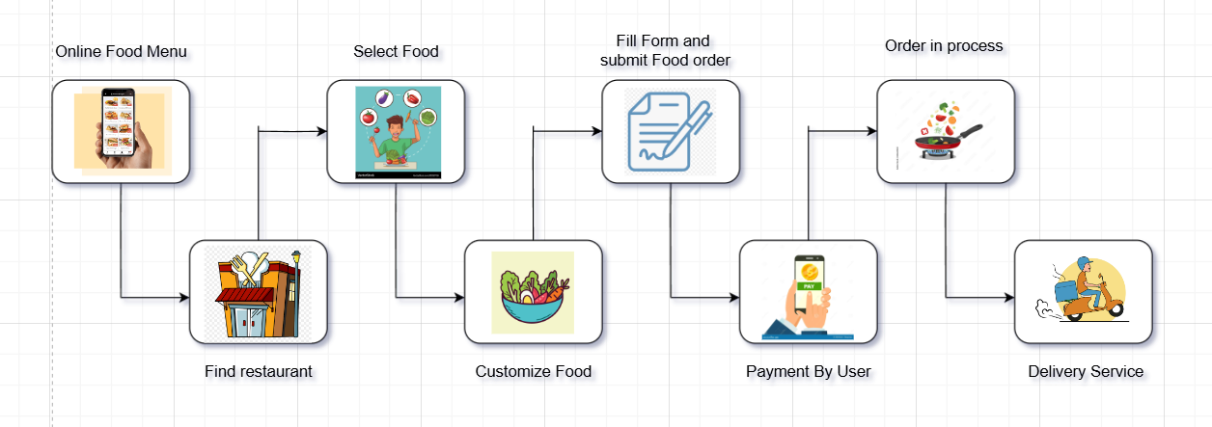
ARCHITECTURE DIAGRAM

Slide 8
SYSTEM SPECIFICATION
HARDWARE SPECIFICATION :
Processing Power :Intel Core i5 (or equivalent) or higher
Memory (RAM): 8 GB or more
Storage: 256 GB SSD
Network: High-speed internet (10 Mbps)
SOFTWARE SPECIFICATION :
Operating System: Windows, macOS, or Linux platforms
Development Tool: Visual Studio Code
Payment Gateway : Gpay, PayPal, Razorpay, Paytm, Phonepe

Slide 9
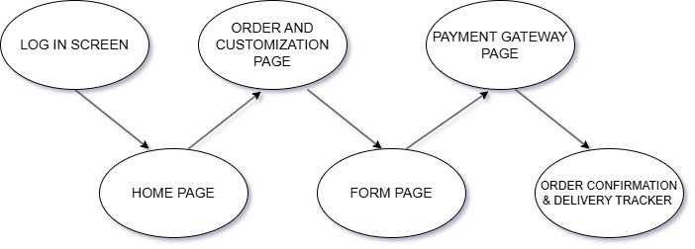
MODULES

Slide 10
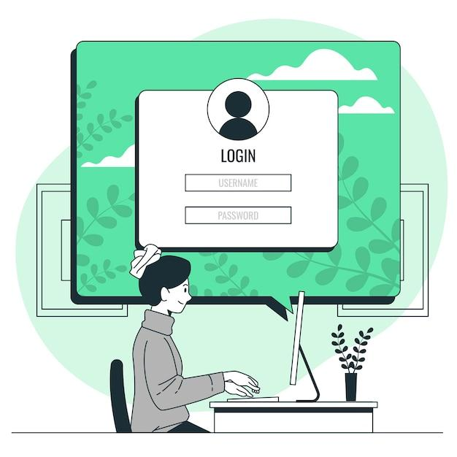
MODULE 1
LOG-IN SCREEN
User enters login credentials (email, phone number, etc.) or signs up if new.
Forgot Password option
Sign-up/Register button for new users

Slide 11
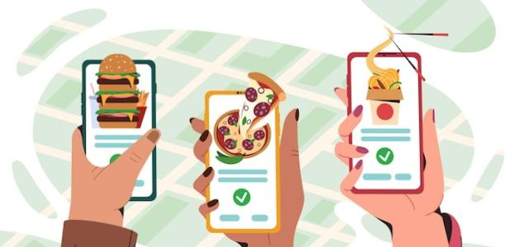
MODULE 2
HOME SCREEN
Description:
Central hub displaying featured items, categories (e.g., Healthy, Vegan, Low-Sugar), and offers. Actions:
Options to search, browse categories, and access personalized recommendations.

Slide 12
MODULE 3
ORDER AND CUSTOMISATION PAGE
A list of available meals with images, brief descriptions, and prices. Users can tap on a meal to view details and begin customization.
Once a meal is selected, users are presented with various customization choices.
1. Sugar Level 2. Salt Level
3. Spice Level 4. Oil Type 5. Additional Dietary Modifications

Slide 13
MODULE 4
FORM SCREEN
Collects the user's address to confirm the delivery location
Users can manually enter their address or select from saved addresses
Address Details: Fields for apartment number, floor, or specific delivery instructions (e.g., “leave at front desk”).
Allows users to set any preferences regarding the delivery
Actions: Enter address, delivery preferences, and optional health conditions

Slide 14
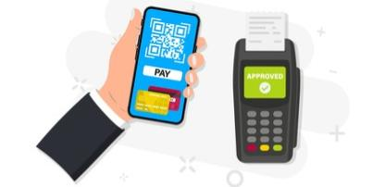
MODULE 5
PAYMENT GATEWAY PAGE
Description:
Secure page to complete payment through various methods (credit card, UPI, etc.).
Actions:
1. Choose payment option
2. Enter payment details
3. Confirm purchase

Slide 15
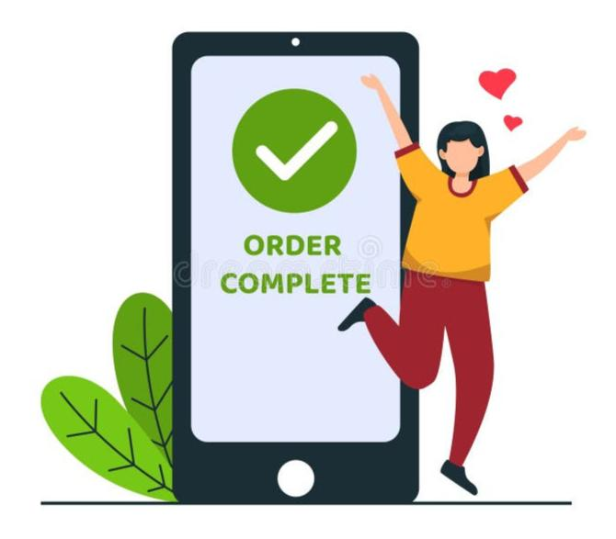
MODULE 6
ORDER CONFIRMATION AND DELIVERY TRACKER
Once the payment is successful, an order confirmation page appears with the order summary and confirmation number.
A page or feature where the user can track the status of their order until it is delivered.

Slide 16
APPLICATIONS
Users can tailor their meals based on individual health requirements (e.g., lower sugar, lower salt) and dietary preferences (e.g., vegan, keto, gluten-free), promoting better health outcomes.
Users can explore a wide range of meal options and customize them.
The app allows for quick meal customization and ordering for home delivery, saving users time and effort in meal preparation and planning.
Multiple payment methods (credit/debit cards, digital wallets, cash on delivery) to cater to user preferences.

Slide 17
CONCLUSION
The Food Customization App provides a unique and personalized food ordering experience, especially for individuals with specific health conditions. By allowing users to adjust the sugar, salt, spice, and other ingredients, it caters to people with a wide variety of health conditions and dietary needs. The app not only improves the food ordering experience but also helps users stay aligned with their health goals.

Slide 18
REFERENCES
1. S.S.Lyer,(2020) A Survey on food ordering systems:Challenges and opportunities.
2. M.A.Al-Shammari,(2021) A Comparative Analysis of food ordering apps: functionalities, security and user experience.
3. R.kumar(2023) Food ordering apps : A systematic review of features, benefits and challenges

Slide 19
THANK YOU

